Slide 1
Predicting consumer behavior with Web search
Sharad Goel et al.(2010), PNAS
Presented by Luoye Chen

Slide 2
Contribution of the Paper
Research question:
How can consumer search behavior used for predicting their collective future behavior days or even weeks in advance?
Previous literature:
Relation between search volume and offline outcomes -> “predict the present”
Ettredge et al.(2005): counts of top 300 search terms correlated with US unemployment data
Eysenbach (2006): high correlation between clicks on flu-related keywords and epidemiological data during the flu season
Choi and Varian (2009): comparing search volume to economic activity (auto and home sales, international visitor statistics)
This paper tried to answer “predict the future”
Extend the domains from epidemiological and macroeconomic time series to consumer activities (movies, music, and video games)

Slide 3
Methodology of the paper
Limitation of conventional prediction methods/approaches:
How can we “correctly” measure the performance of our prediction results?
Example: Santa Fe, New Mexico
300 sunny day in a year
A prediction of sunshine every day would be correct 82% of the time, yet hardly impressive.
Performance is relative:
The predictive power of search should be judged in relation to statistical models fit with traditional data sources, prediction markets, or expert opinions.

Slide 4
Methodology of the paper
Identify user intent from queries
Map queries to specific movies/video games/music by extracting the names in the link
Movie data on revenue, budget, number of opening screens: IMDb
Sales & Critic ratings data for video games: VGChartz(vgchartz.com)
Music data (artist, song title, rank and chart release date): Hot 100 chart issued weekly by the magazine Billboard

Slide 5

Methodology of the paper
Log linear models
Google flu trends

Slide 6
Methodology of the paper
Combined models:
Incorporating both search and baseline data
Fit a linear model including search data , production budgets, opening screens, and HSX estimates.
Level-one-out estimation

Slide 7
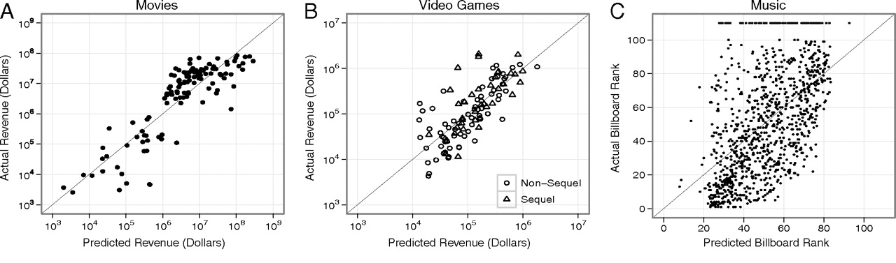
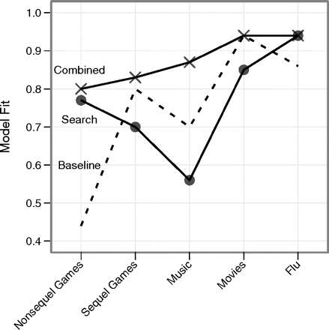
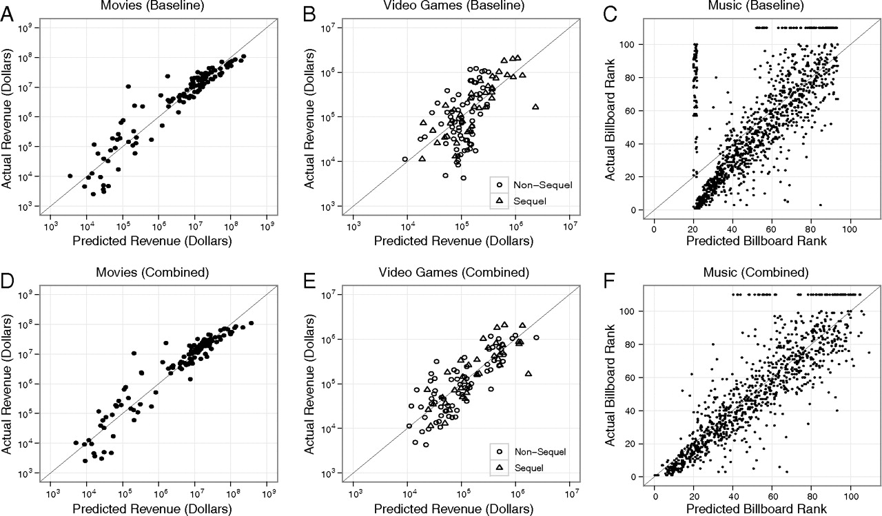
Fig. 5.The correlation between predicted and actual outcomes for movies, video game sequels and nonsequels, music, and flu.
Fig. 3.Predictions from the baseline (A–C) and the combined baseline-plus-search models (D–F) for movies, video games, and music.

Slide 8
Review of the paper
Method strengths:
Baseline is important!
Relative value of search data compared to alternative sources
Combined model approach can boost the performance of prediction
Real-time reflection:
Search data can be collected for many domains simultaneously and easily analyzed along geographic and other dimensions, all in real time (amazon, google)
Method limitations:
Size of the relevant population
Offline outcomes:
Revenue?
Connection between search behaviors and offline outcomes (Movies v.s. Music)
Identifying relevant queries

Slide 9
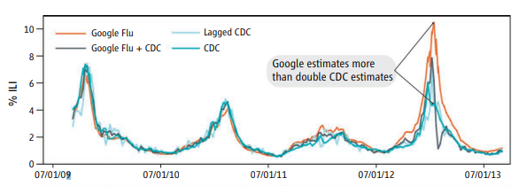
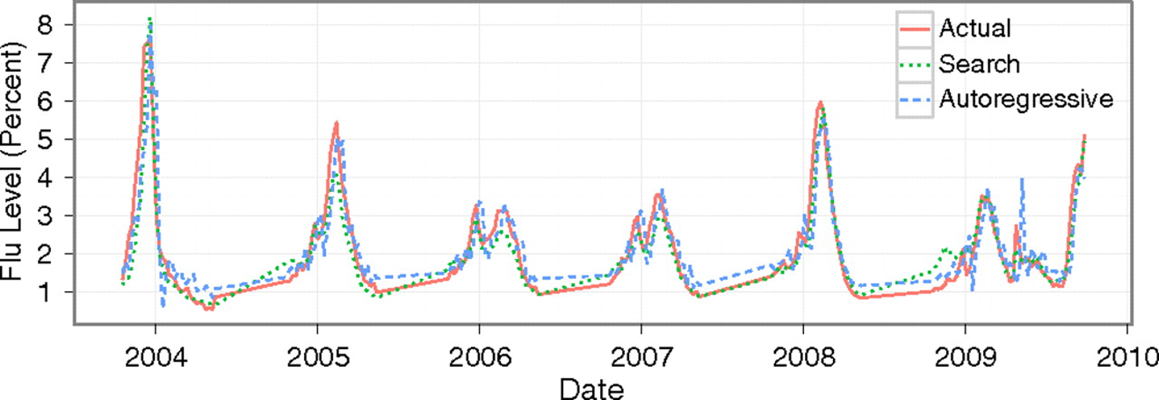
Google flu trend (GFT)
Ginsberg, Jeremy, Matthew H. Mohebbi, Rajan S. Patel, Lynnette Brammer, Mark S. Smolinski, and Larry Brilliant. "Detecting influenza epidemics using search engine query data." Nature 457, no. 7232 (2009): 1012.
GFT missed the peak of the 2013 flu season by 140 percent.
Lazer, David, Ryan Kennedy, Gary King, and Alessandro Vespignani. "The parable of Google Flu: traps in big data analysis." Science 343, no. 6176 (2014): 1203-1205.

Slide 10
The point of our paper was not to bury big data—our own research has demonstrated the value of big data in modeling disease spread, real time identification of emergencies, and identifying macro economic changes ahead of traditional methods. But while Google’s efforts in projecting the flu were well meaning, they were remarkably opaque in terms of method and data—making it dangerous to rely on Google Flu Trends for any decision-making.
David Lazer, posted on the Wired Opinion
https://www.wired.com/2015/10/can-learn-epic-failure-google-flu-trends/

Slide 11
Questions
1. How can prediction method help economic studies?
2. Small data v.s. Big data
Google Flu Trend Model:
over 50 million search keywords
less than 50 flu types
3. How to set up a meaningful/effective baseline to evaluate the performance of predictions?

